Slide 1
President’s Updates
In Service Day
August 10, 2012

Slide 2
Navigator Online Resource
Located under “Faculty and Staff”
Added:
  Organizational Handbook
  In Service Day
  Under Committees: Chair Resources

Slide 3
New Organizational Structure
Began initial planning in February
Looked for ways to reduce costs and the number of managers
Identified most critical needs and ways to shift the work
Began discussions with the Chancellor in May
Presented to Crafton Council at the last meeting in May

Slide 4
New Organizational Structure
Discussions in Chancellor’s Cabinet in June
First reading by the Board in July
Presented to the campus in President’s letter in July
Open Q&A in July
Approved August 9
Net Annual Salary Savings: $160,000
Number of managers reduced by 1

Slide 5
Interim President
Interim Executive Vice President, Instruction &
Student Services
Dean
Institutional
Effectiveness
Director,
Grants & Resource
Development
Vice President
Administration
Interim
Executive Dean
Assistant
Director
Director,
Facilities, M&O,
Custodial, Construction
Dean Instruction
Dean Instruction
Director,
Technology Services
Campus Business Office
Dean
Student Services
Dean
Student Services
Director,
Bookstore
Supervisor,
Food Services
Director
Aquatics

Slide 6
New Organizational Structure
Rebeccah Warren-Marlatt – Interim Exec VP of Instruction and Student Services
Rick Hogrefe – Interim Exec Dean
  Keeps the Arts and Sciences Division
  Adds Curriculum and Scheduling
Keith Wurtz – Dean of Institutional Effectiveness
Karen Childers – Director of Grants and Resource Development
Larry Cook – Director of Facilities

Slide 7
Welcome and Congratulations
Steve Rush – Reclassified as A&R Specialist
Michelle Riggs – Reclassified as Research Analyst
Michelle Tinoco – A&R Technician
Breanna Andrews – ASL Faculty
Dean Papas – English Faculty
Tricia Menchaca – STEM Pathways Coordinator

Slide 8
Welcome and Congratulations
Robert Brown – STEM Alternatives Learning Strategies Coordinator
Jonathan Townsend – Interim Tutoring Center Coordinator
Dawn Williams – Library Media Clerk
Jeremy Crooks – Custodial Supervisor
Andrea Moreno – Public Safety Secretary
Deborah Wasbotten – CDC Manager

Slide 9
Farewell & Best Wishes
Sam Job – Librarian
Merrill Deming – Math
David Williams – Math Tutoring

Slide 10
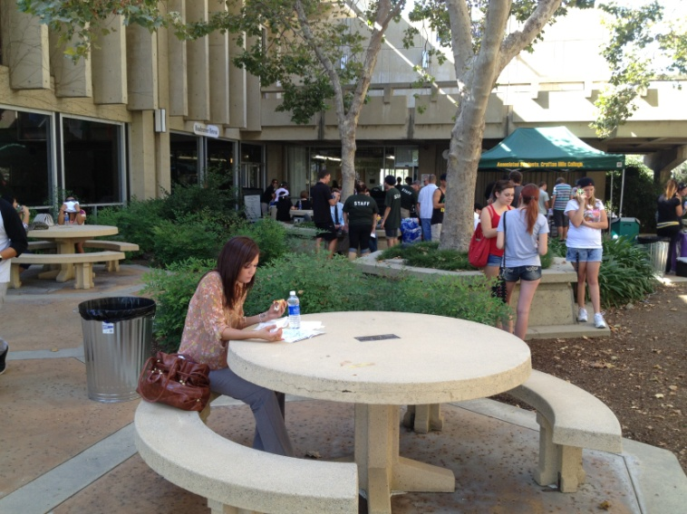
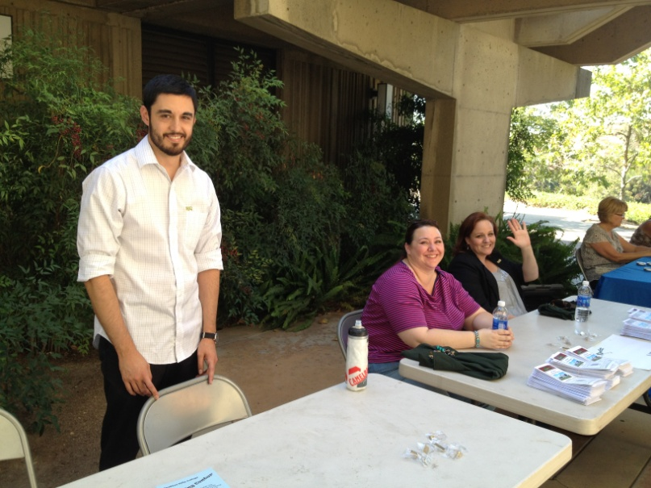
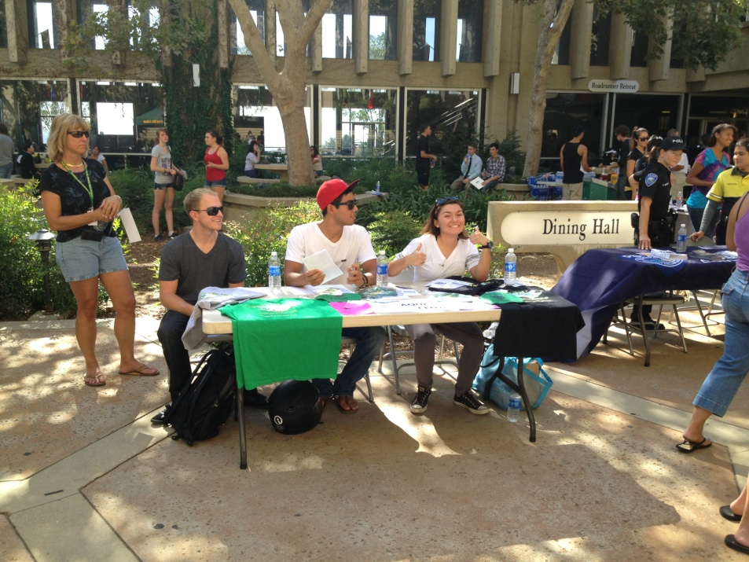
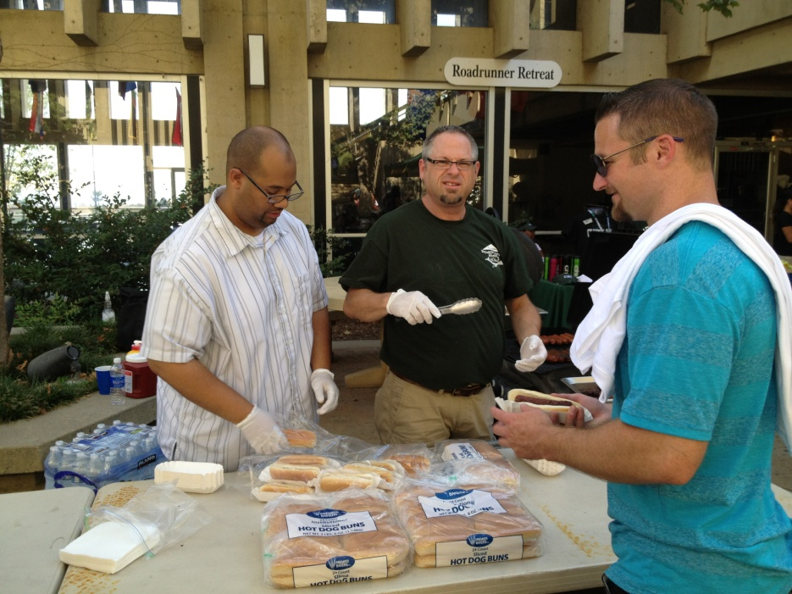
Road Runner Rally

Slide 11
President’s Remarks
In Service Day
August 10, 2012

Slide 12
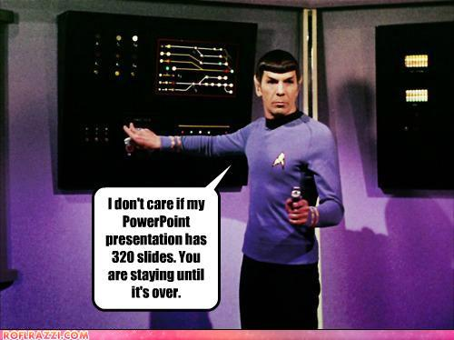

Slide 13
Introduction
Share my perspective, vision, and goals
Prepare us for the year and beyond
“You have brains in your heads.
You have feet in your shoes.
You can steer yourself in any
direction you choose.”
― Dr. Seuss

Slide 14
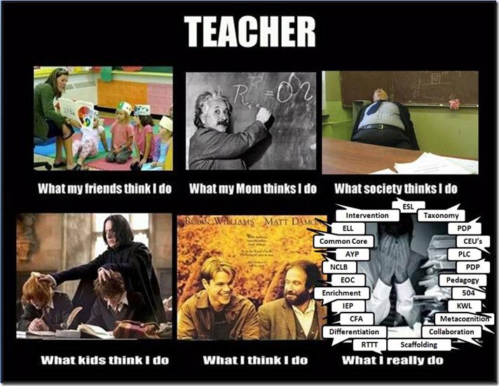

Slide 15
External Environment
Economy
State Budget
Accountability and Visibility
Demographics of our students
“I have never let my schooling interfere
with my education.” ― Mark Twain

Slide 16
Key Points
People Matter
Open Communication
Do Stuff
Goals and Proposed Actions for 2012-2013

Slide 17
People matter
Individual Value
Interpersonal Relationships

Slide 18
Our Resiliency
Probation to Reaffirmation in 2 Years
Reduction of classes – 18% in three years
  “Whom Shall We Serve?”
Reduction in staffing
Personal losses
Lots of change

Slide 19
People Matter
People
  The most important part of ANY organization
  The only part that has the potential to become more valuable over time
Growth and development
Joy in your work
Engagement with the organization

Slide 20
How We Treat Each Other Matters
Internal Customer Service
  “Under-promise; over-deliver.” ― Tom Peters
Accountability vs Blame
  subject to the obligation to report, explain, or justify something; responsible; answerable.
  an act of attributing fault; censure; reproof.
  Get mad then get over it
“Don't let yesterday take up too much of today.” ― John Wooden

Slide 21


Slide 22
Open communication
Transparency
Collaboration
Inclusiveness

Slide 24
Transparency
Planning processes and decision-making are transparent when:
  People are open and honest about how and why decisions are made, appropriate information is readily accessible and is shared in a timely manner.

Slide 25
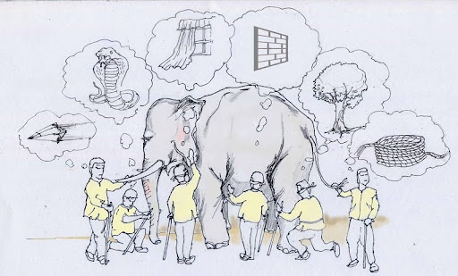

Slide 26
Collaboration
Planning processes and decision-making are
collaborative when people across departments, divisions, and job classifications are working together to share knowledge and build consensus toward a common purpose.
evidence based when they are informed by the analysis of reliable and objective evidence balanced with collective wisdom.

Slide 27
Inclusiveness
We promote inclusiveness when we take proactive steps to ensure everyone has the opportunity to be involved and each person’s input is equally valued.
“I am only one; but still I am one. I cannot do everything, but still I can do something; I will not refuse to do something I can do.”
― Helen Keller

Slide 28
Do Stuff
Planning
Results
Try Something New
Keep Getting Better

Slide 29
Planning for Results
Planning processes and decision-making are
effective when they produce meaningful and relevant results
Develop a Plan
Achieve Results
Measure and Evaluate
“What's measured improves”
― Peter F. Drucker

Slide 30
Try Something New
Experimentation, Creativity, Innovation
  Do something new
  Take action
  Learn
“Insanity is doing the same thing, over and over again, but expecting different results.”
― Albert Einstein
“I believe that the most important single thing, beyond discipline and creativity is daring to dare.”
― Maya Angelou

Slide 31
Examples
UCR Medical School
  If you were starting a college from scratch, what would it be like? How would you design it? What elements would it include?
  Team based problem solving, realistic practice, and a dean of student success
Lee Shulman & The Carnegie Foundation
  How do we construct an educational world in which success is the constant?
  Quality of instruction, social connection, the experience of success

Slide 32
QEI 2 – Course Retention Rate
The overall CHC Retention Rate has increased every year in the last five years from 86.9% in 2007-08 to 89.5% in 2011-12.

Slide 33
QEI 1 – Course Success Rate
The overall CHC Success Rate has increased the last three years from 70.6%in 2009-10 to 74.2% in 2011-12.
The developmental course success rate has increased every year in the last five years from 58.5% to 65.5%.

Slide 34
QEI 7 – Performance After Transfer
The California State University GPA of former Crafton Hills College students has consistently been over 3.00 in the last five years.

Slide 35
Learning from Mistakes
Tolerance for mistakes
“Anyone who has never made a mistake has never tried anything new.” ― Albert Einstein
You can never learn less; you can only learn more. The reason I know so much is because I have made so many mistakes."
— Buckminster Fuller

Slide 36
Proposal for 2012-2013
BHAGs
Proposed Actions

Slide 37
BHAGs
Build systems and processes to sustain and enhance student success and a quality learning environment
Build a culture that is collaborative, innovative, appreciative, fun, and action-oriented
Enhance participative decision making allowing all voices to be expressed
Develop people to perform at a level of excellence and to achieve their career goals

Slide 38
BHAGs
Maintain fiscal responsibility
Manage construction projects for aesthetics and fiscal efficiency
Preserve and advance the College’s image in the community
As a campus, embody our values: creativity, inclusiveness, excellence, and learning centeredness

Slide 39
My Proposal
We focus on students
  Everyone has a part in their educational experience
We become a community of scholars
  Learners, experts in our roles
  Interconnected
  Share information
“It's what you learn after you know it
all that counts.” — John Wooden

Slide 40
My Proposal
We are “revolutionary” in our efforts to help students succeed
We engage or re-engage in our work and our organization
  Find some joy in our work and our profession
We respectfully hold one another accountable
“Only those who risk going too far can possibly
find out how far they can go.“ — T.S. Eliot

Slide 41
My Responsibilities to You
Shape the environment so you can do these things
Be a facilitator
Seek out information and input
Share the big picture
Stifle fear
Never let the fear of striking out get in
your way."
— Babe Ruth

Slide 42
My Responsibilities to You
Walk the talk
Earn your trust
Be myself and also keep growing
  Learn from mistakes
Make the tough decisions

Slide 43
Closing Thoughts
“Never doubt that a small group of thoughtful committed citizens can change the world. Indeed, it is the only thing that ever has.” — Margaret Mead
“All labor that uplifts humanity has dignity and importance and should be undertaken with painstaking excellence.” ― Martin Luther King, Jr.
“Let's make a dent in the universe.” — Steve Jobs

